Slide 1
report of task 2 cybersecurity internship
Internship studio
Creator name: Avirup pal

Slide 2
Vulnerability shown in netsparker software: Screenshots of the vulnerability details in the following slides:

Slide 3
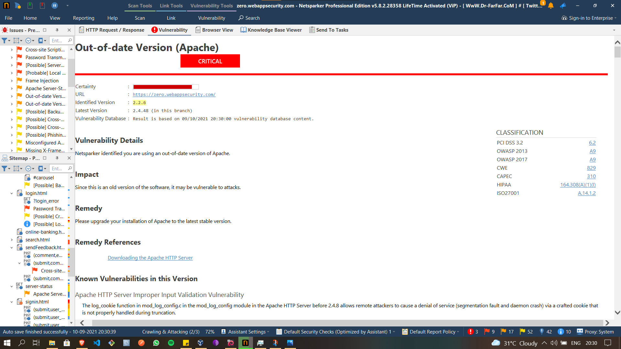

Slide 4
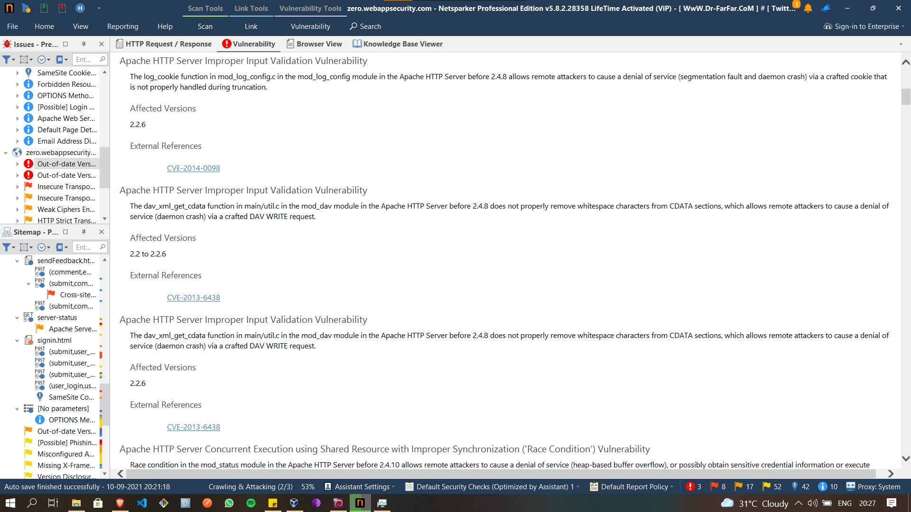

Slide 5
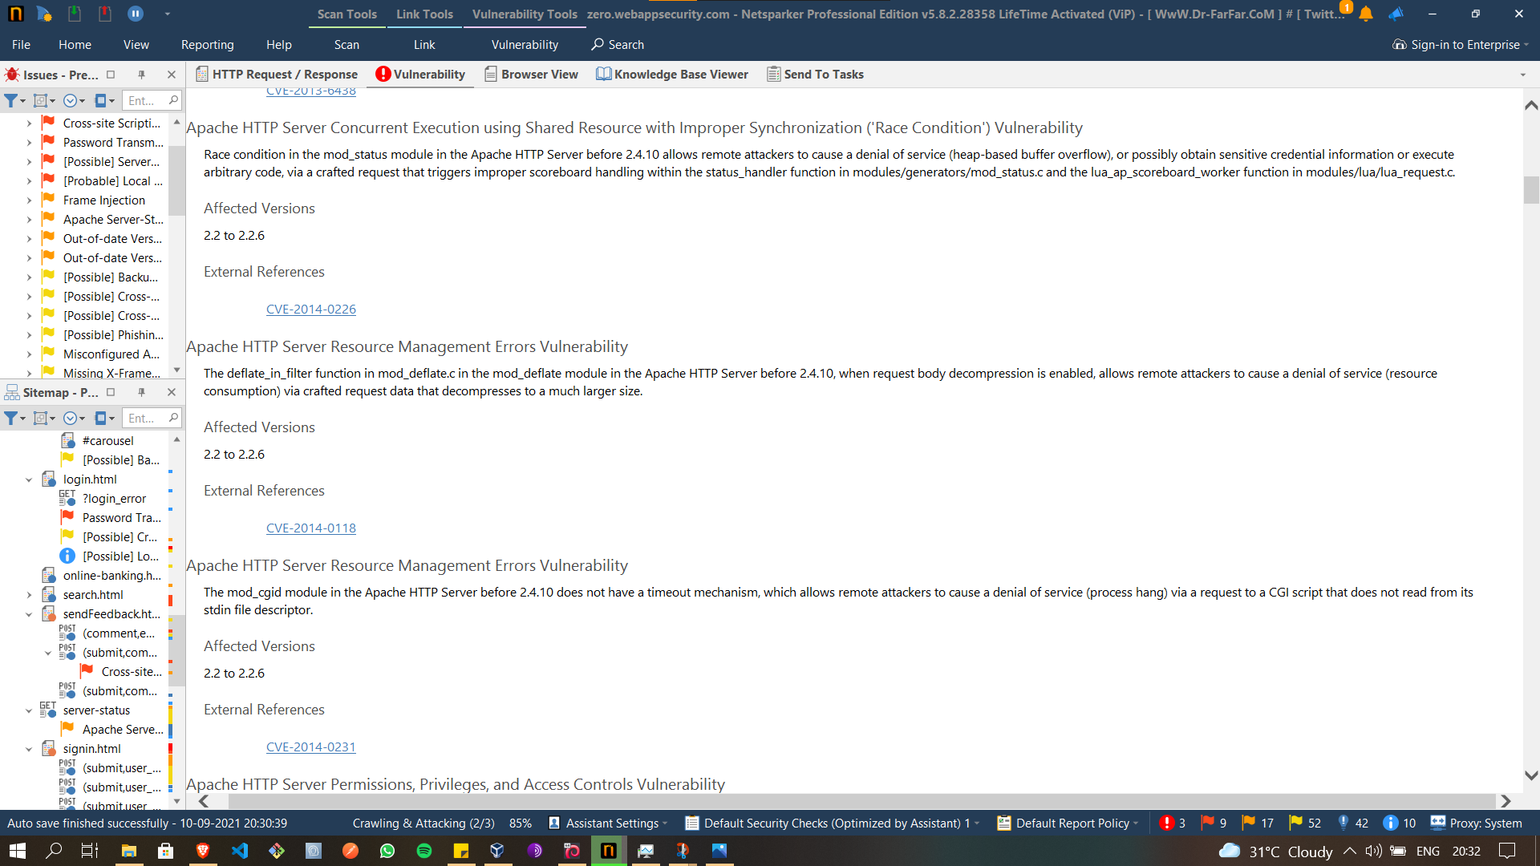

Slide 6
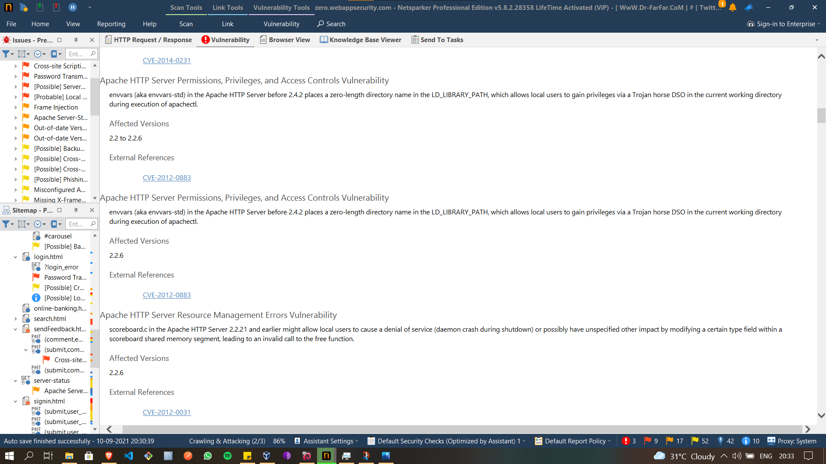

Slide 7
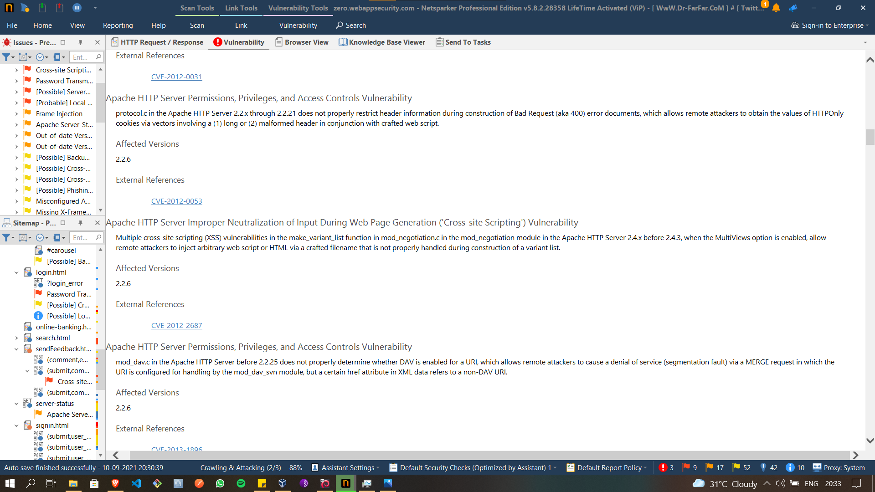

Slide 8
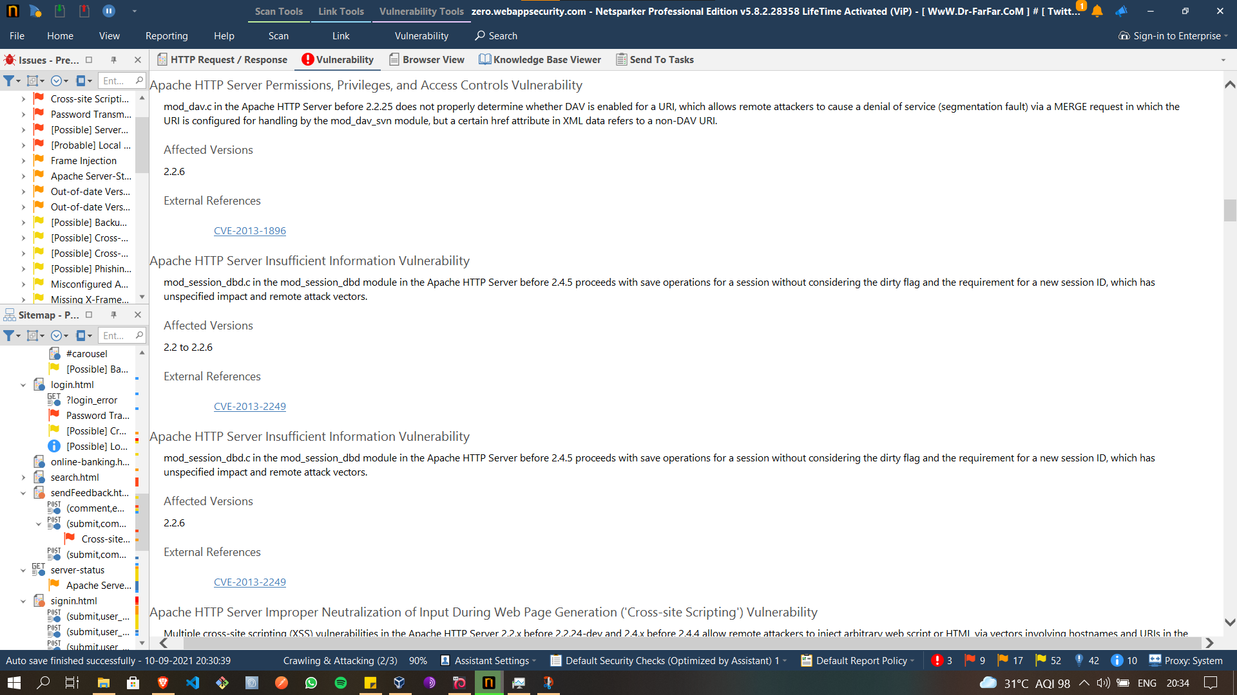

Slide 9
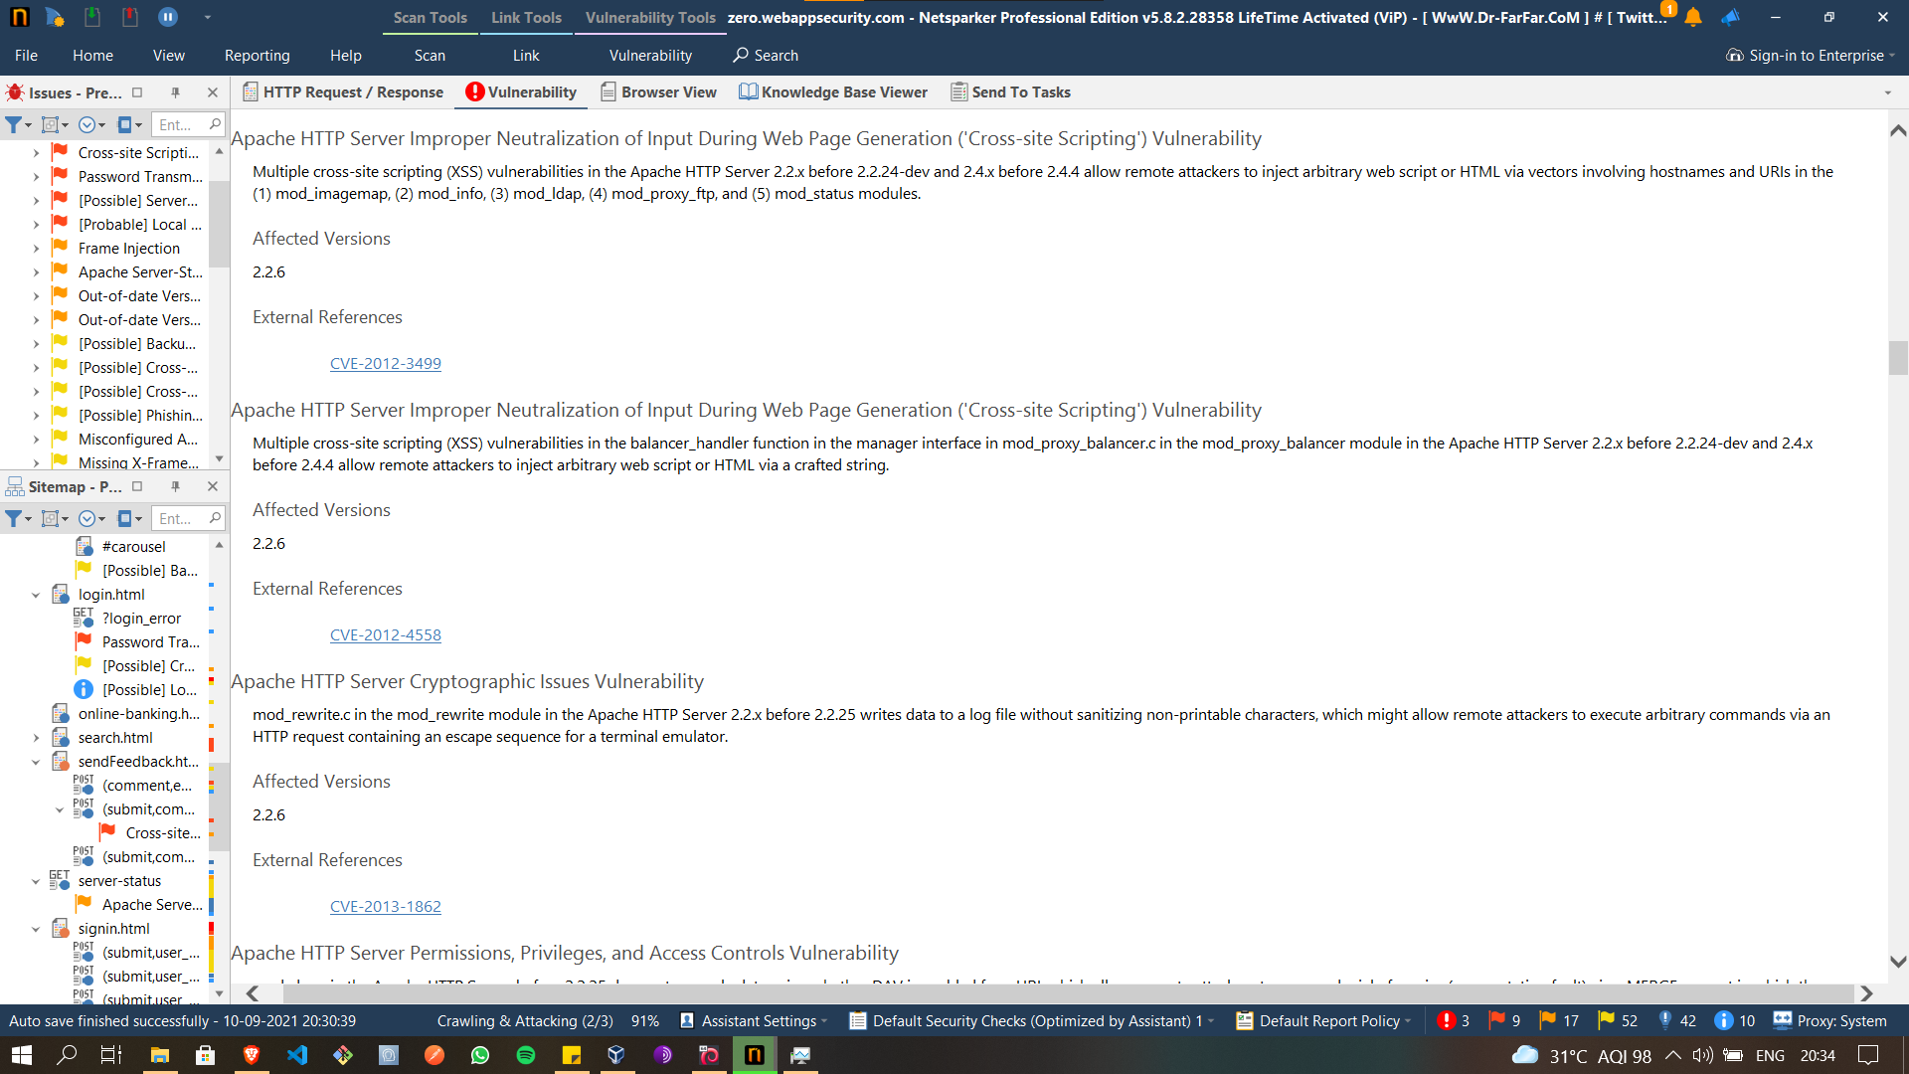

Slide 10
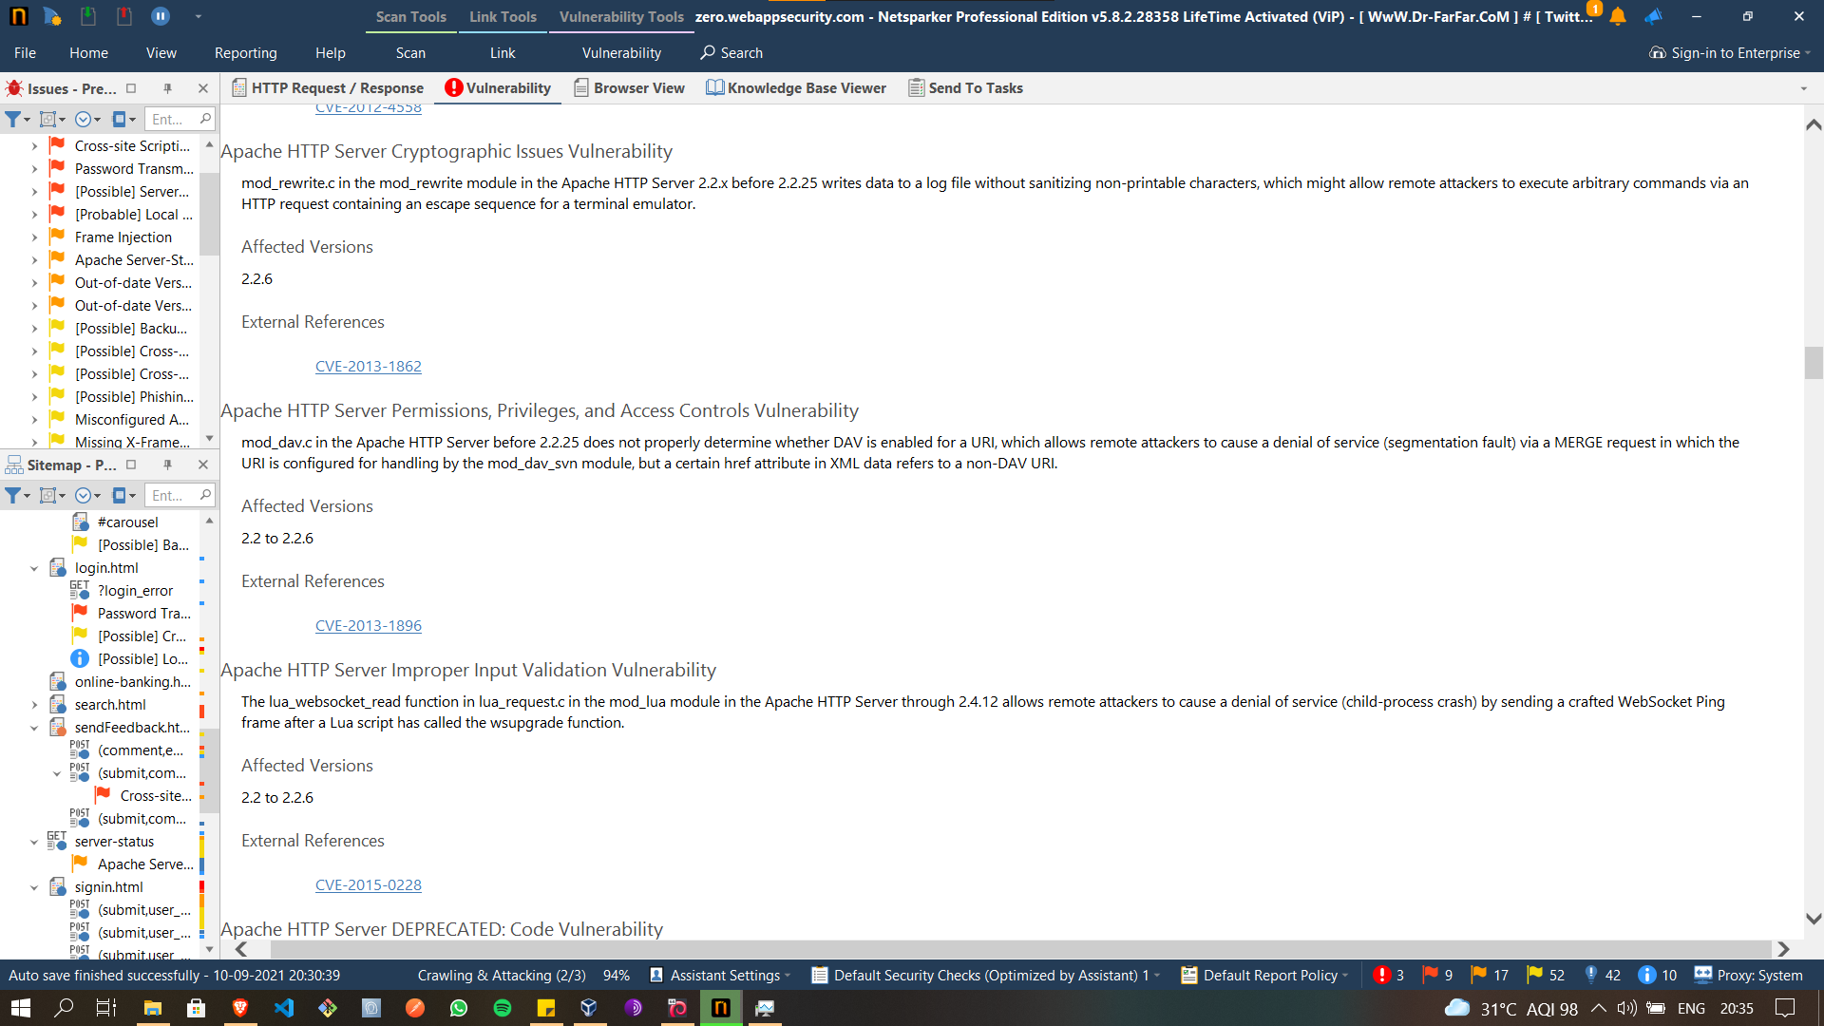

Slide 11
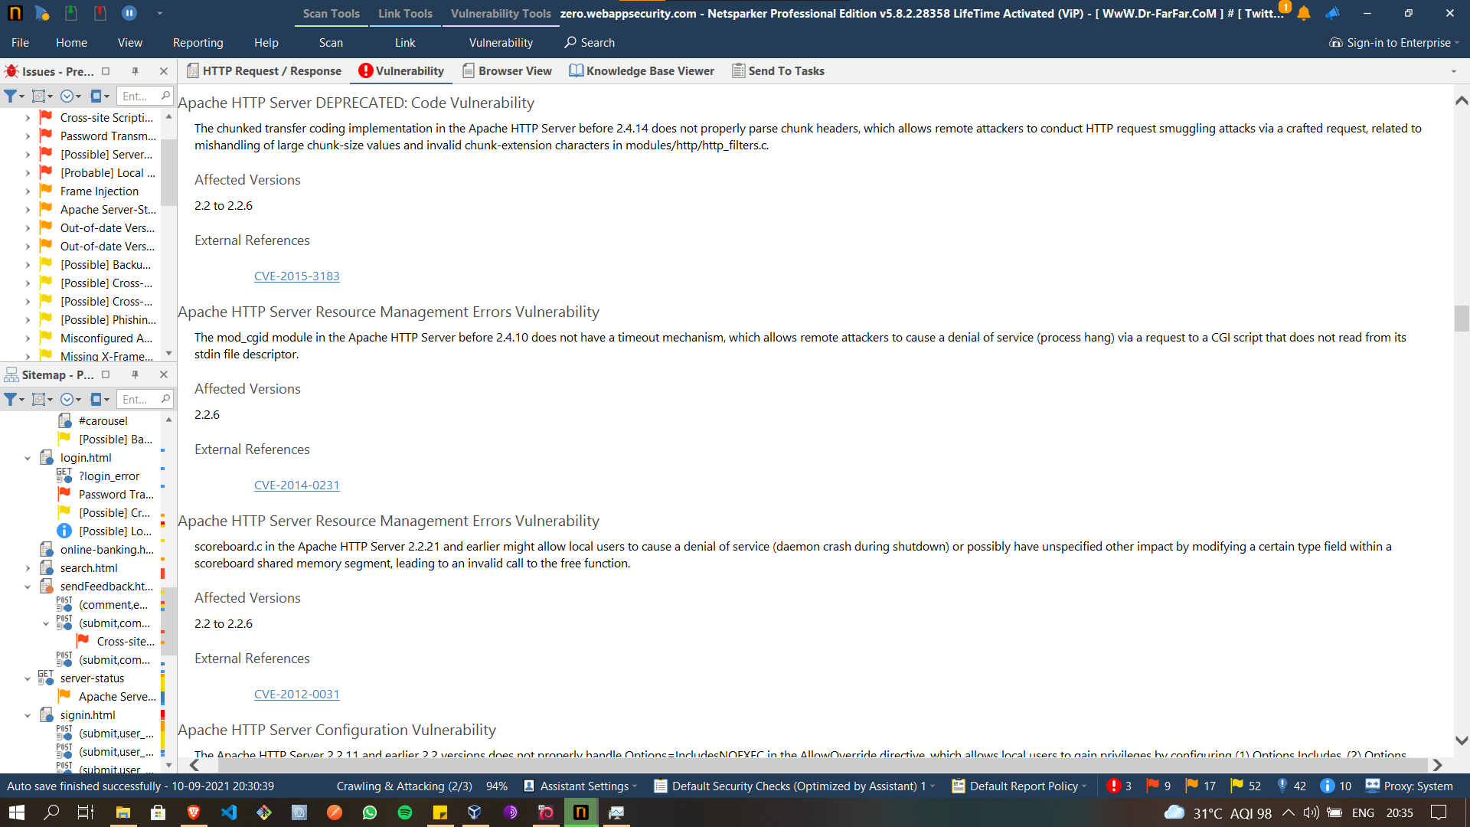

Slide 12
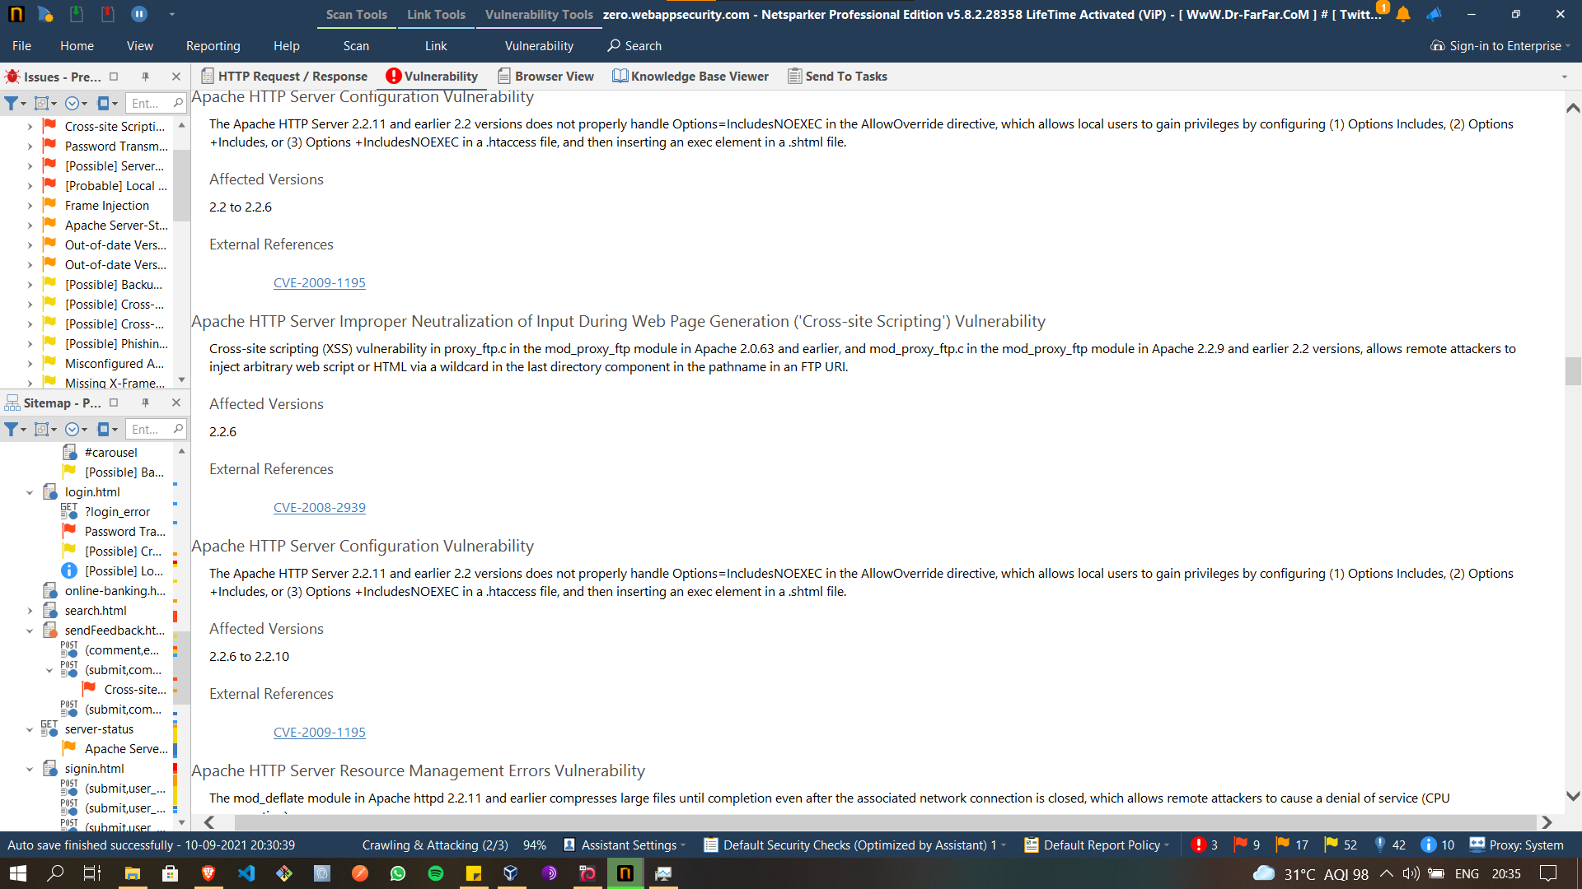

Slide 13
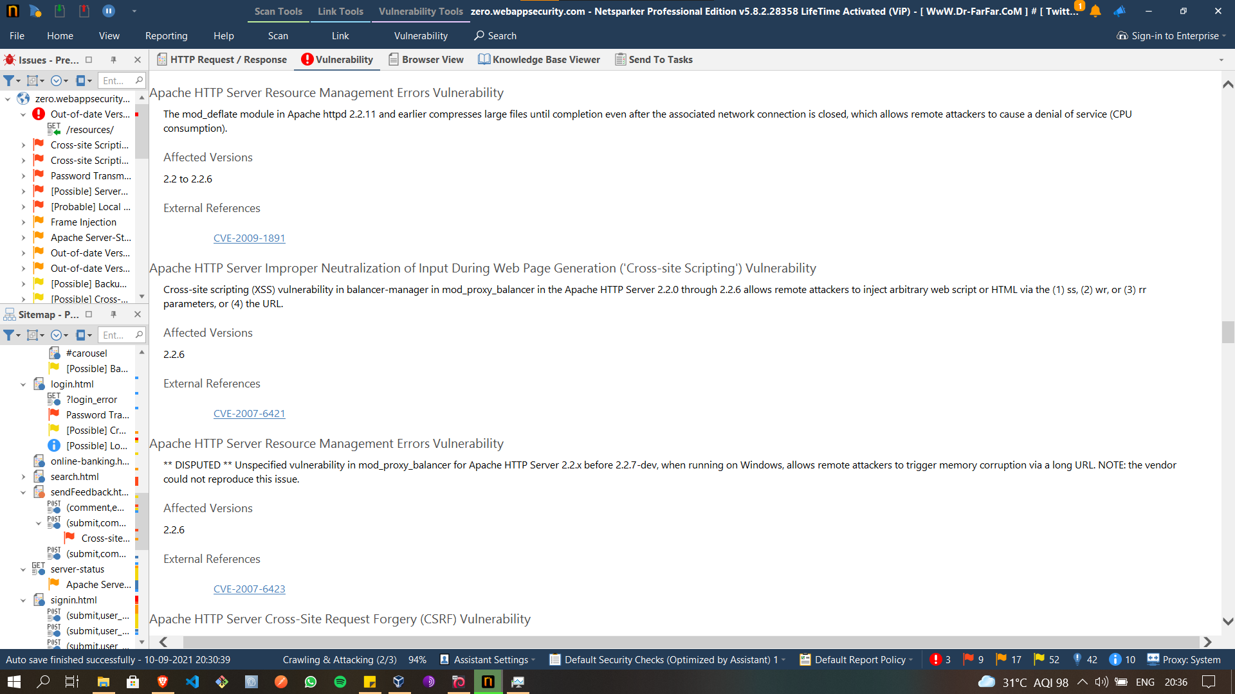

Slide 14
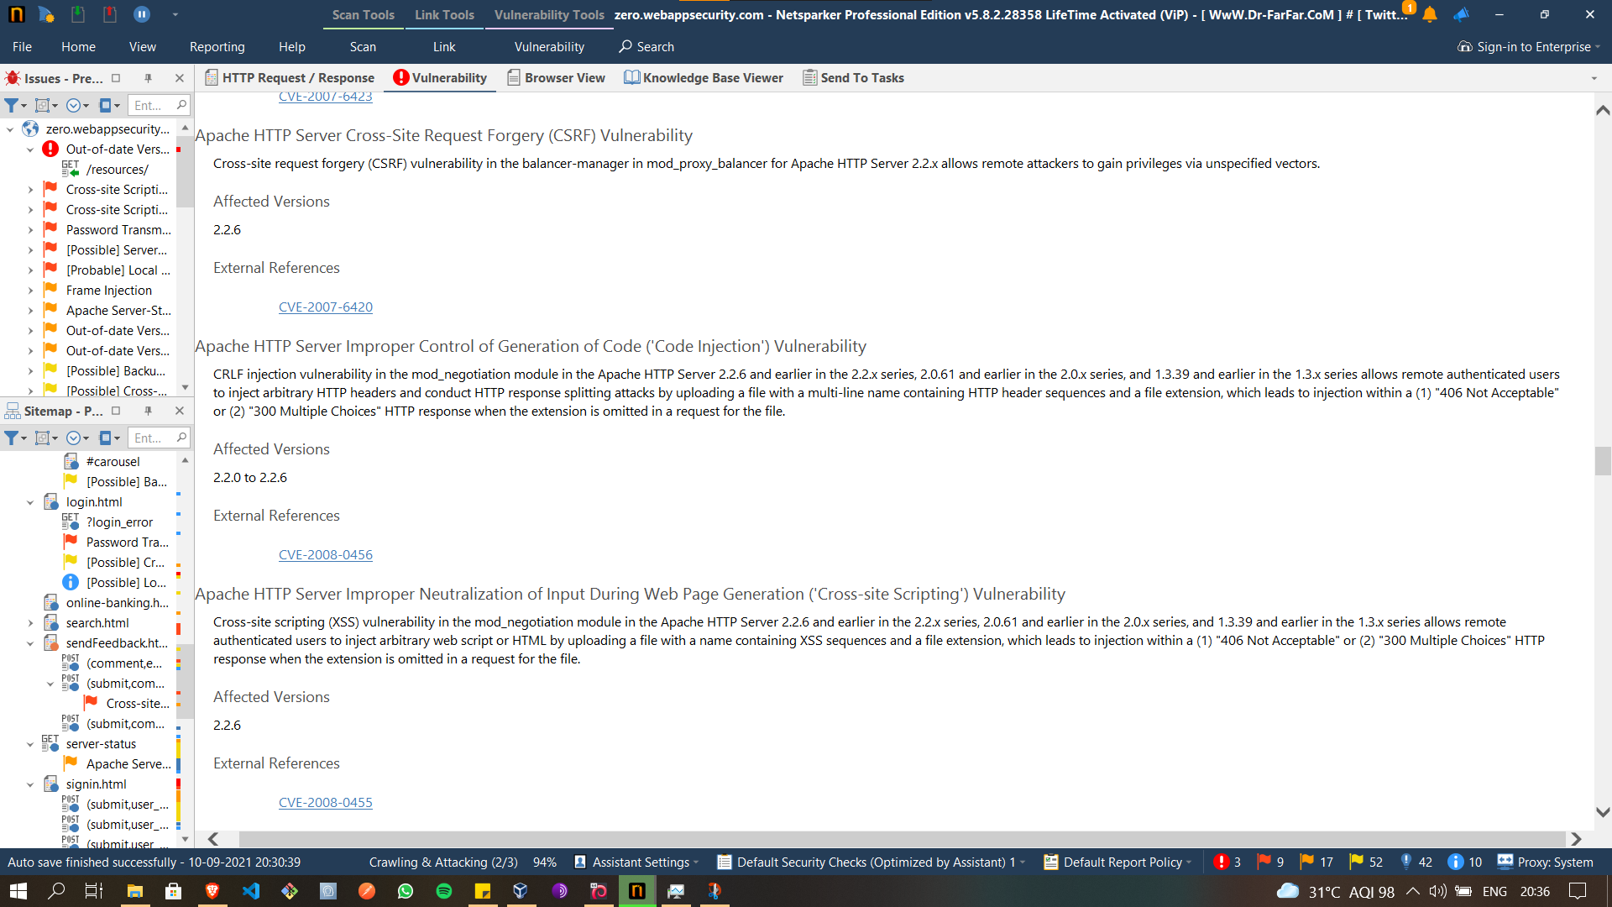

Slide 15
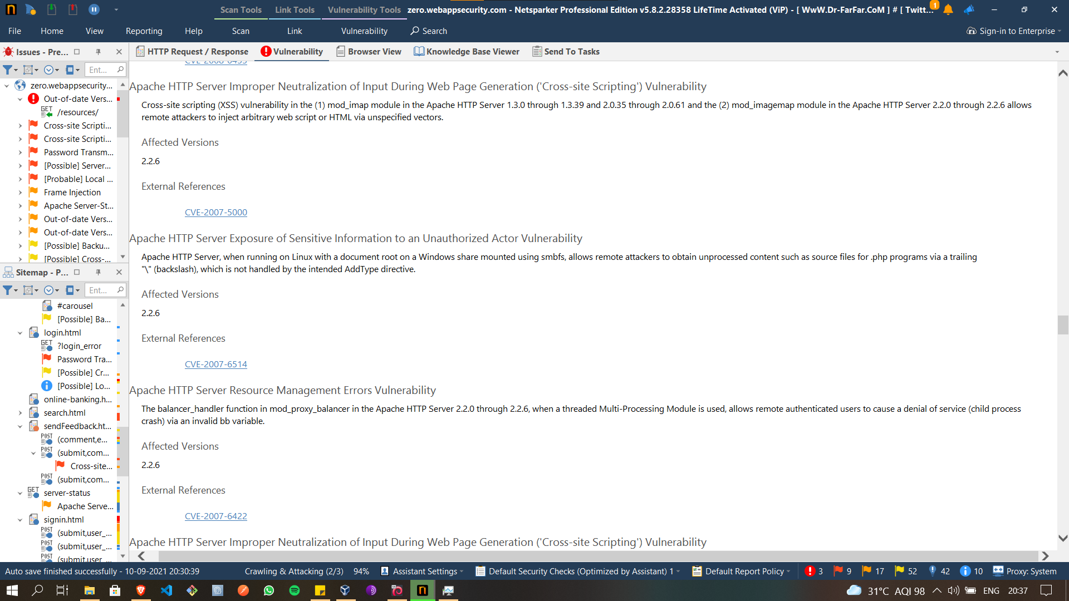

Slide 16
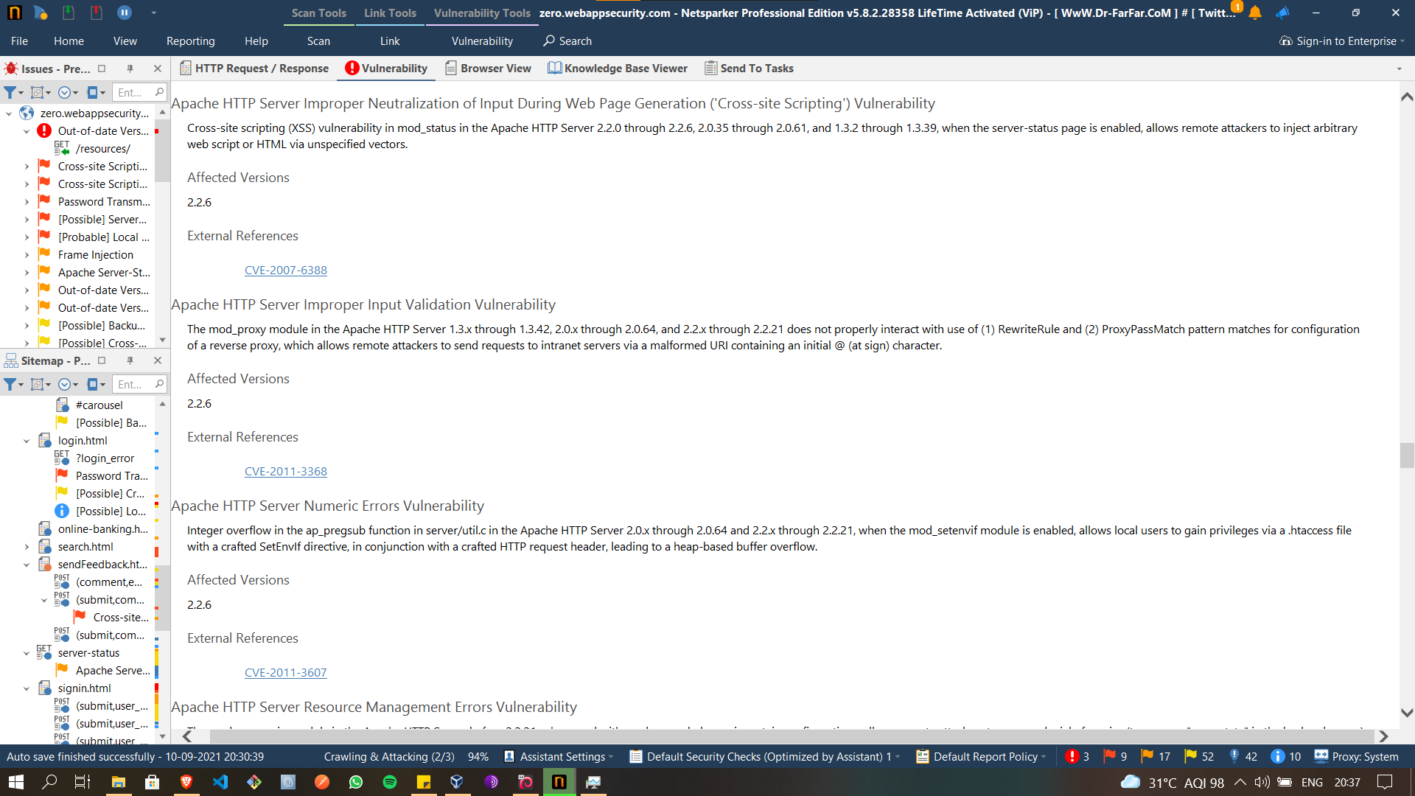

Slide 17
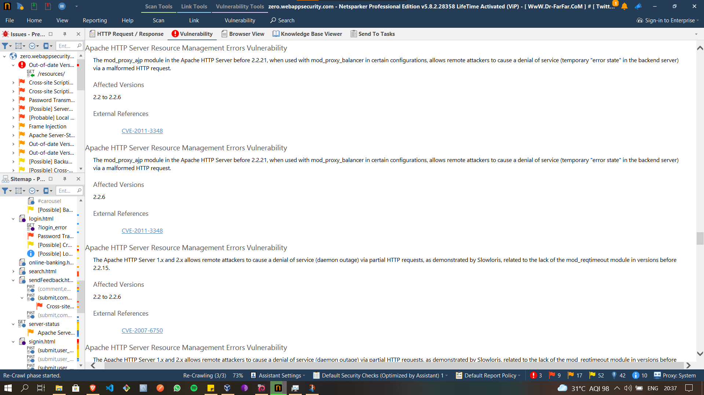

Slide 18
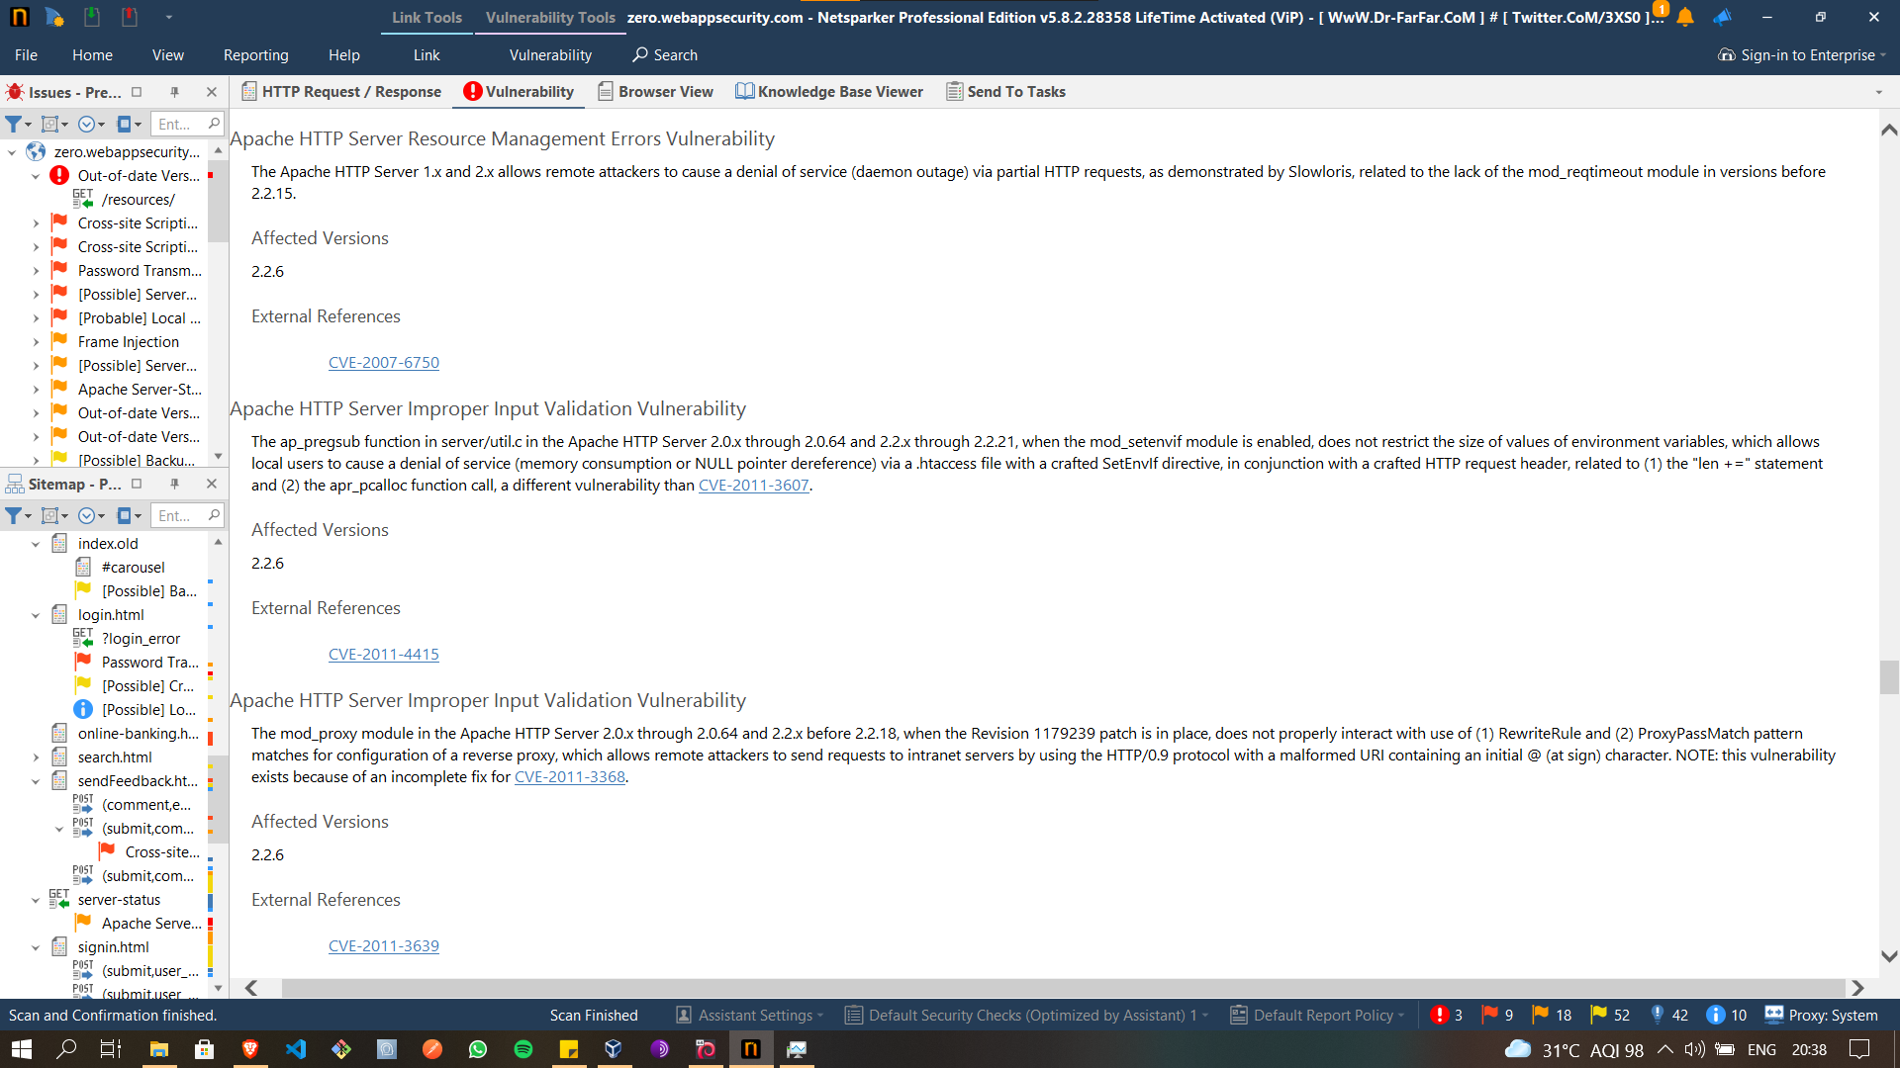

Slide 19
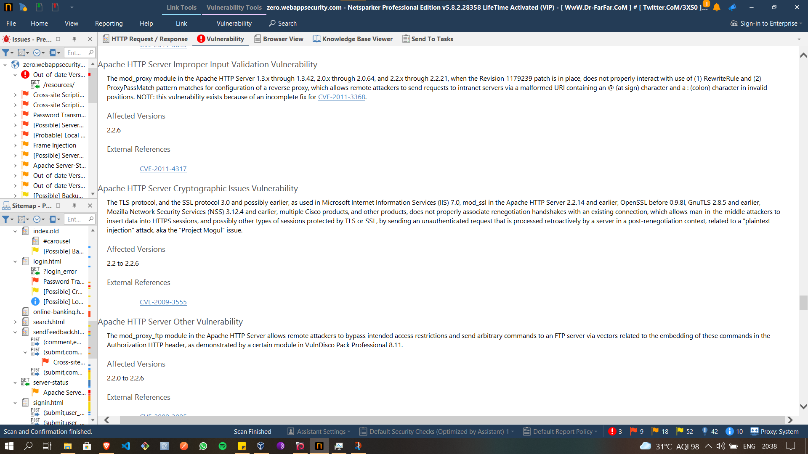

Slide 20
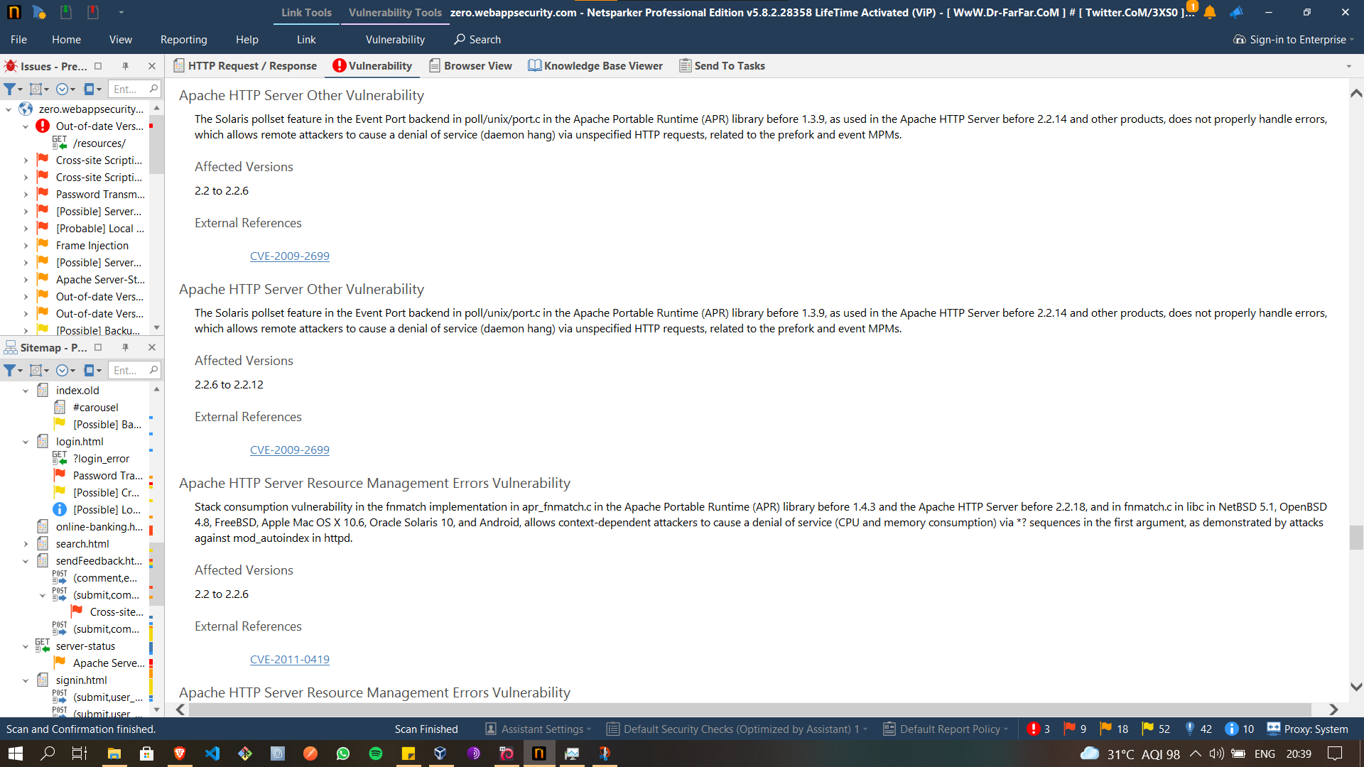

Slide 21
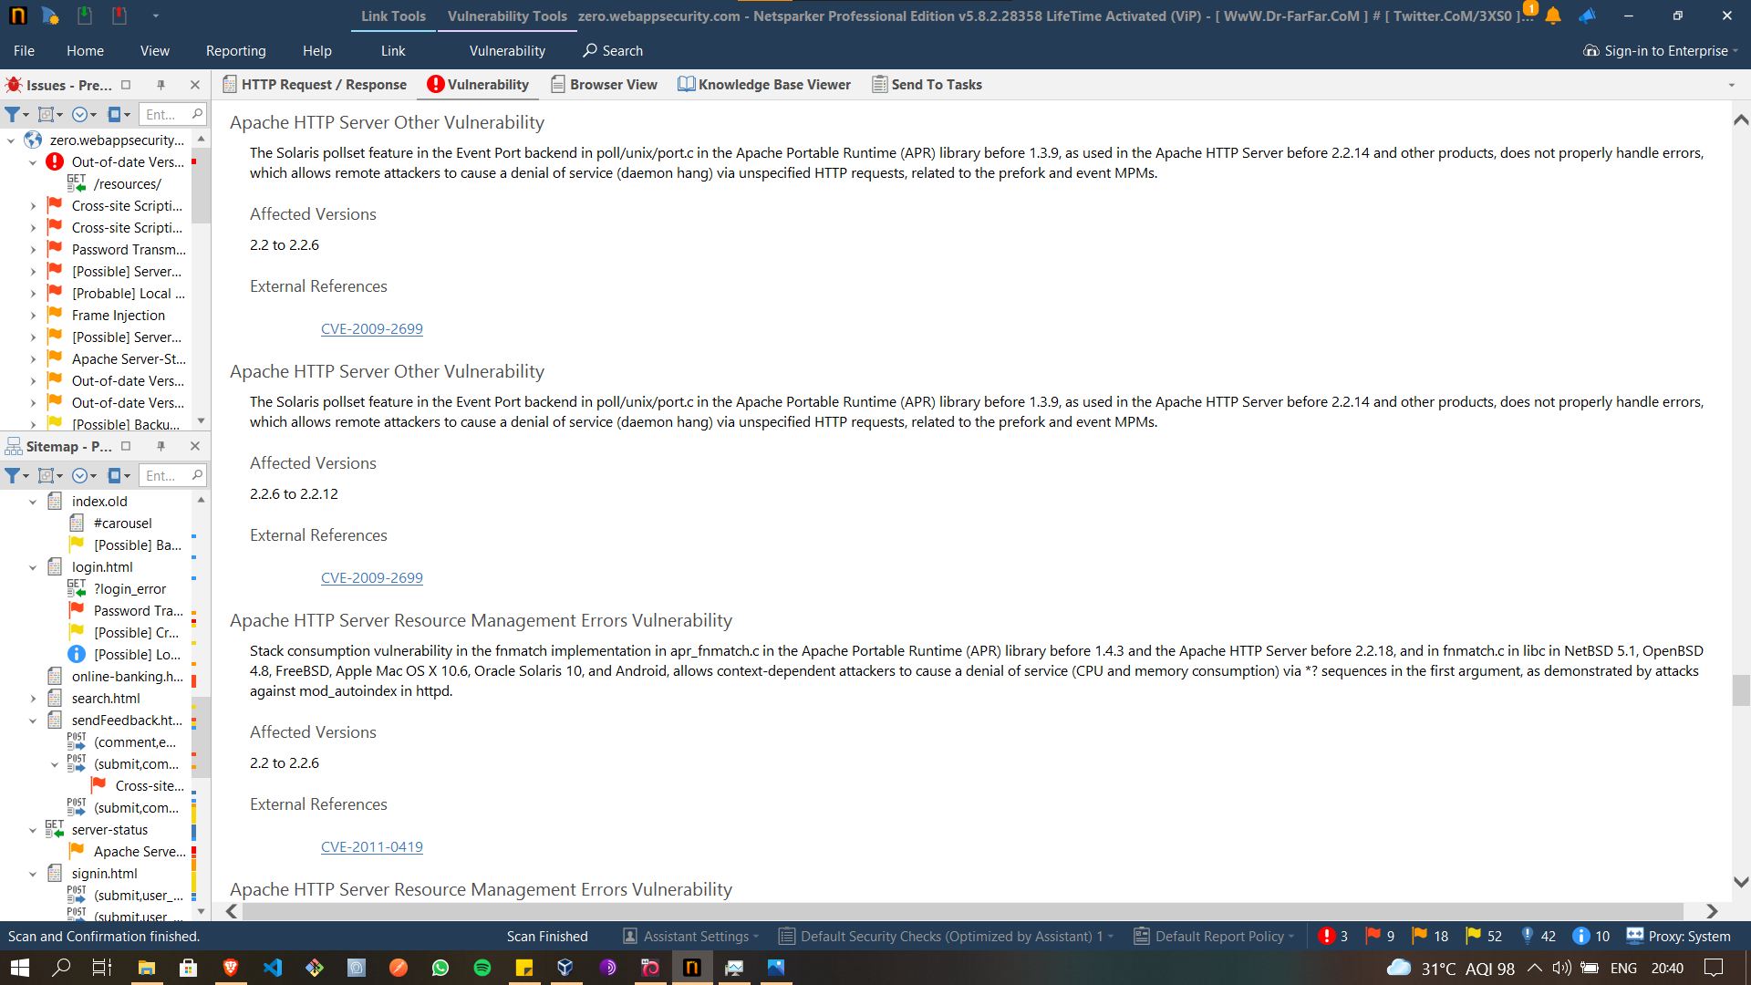

Slide 22
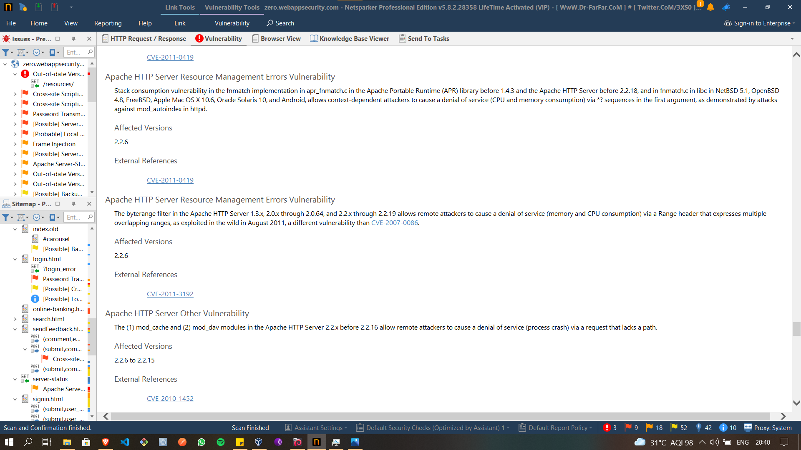

Slide 23
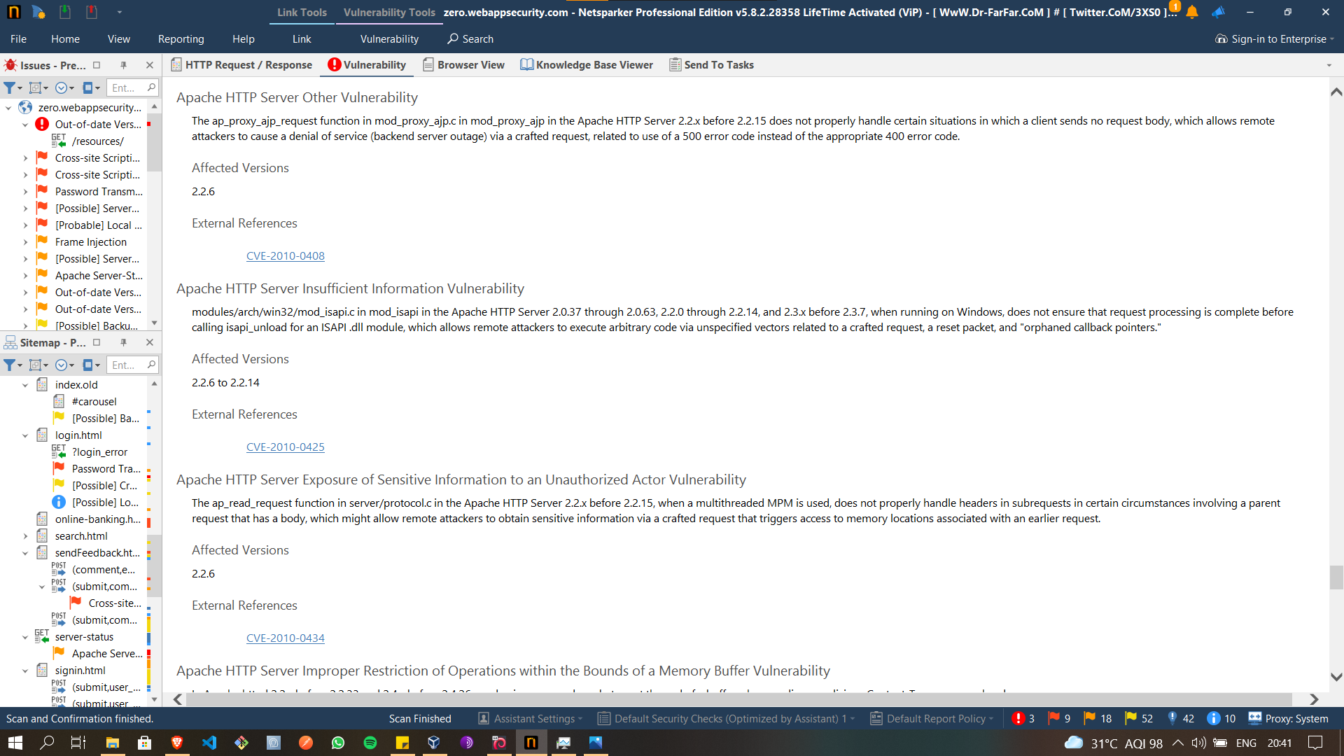

Slide 24
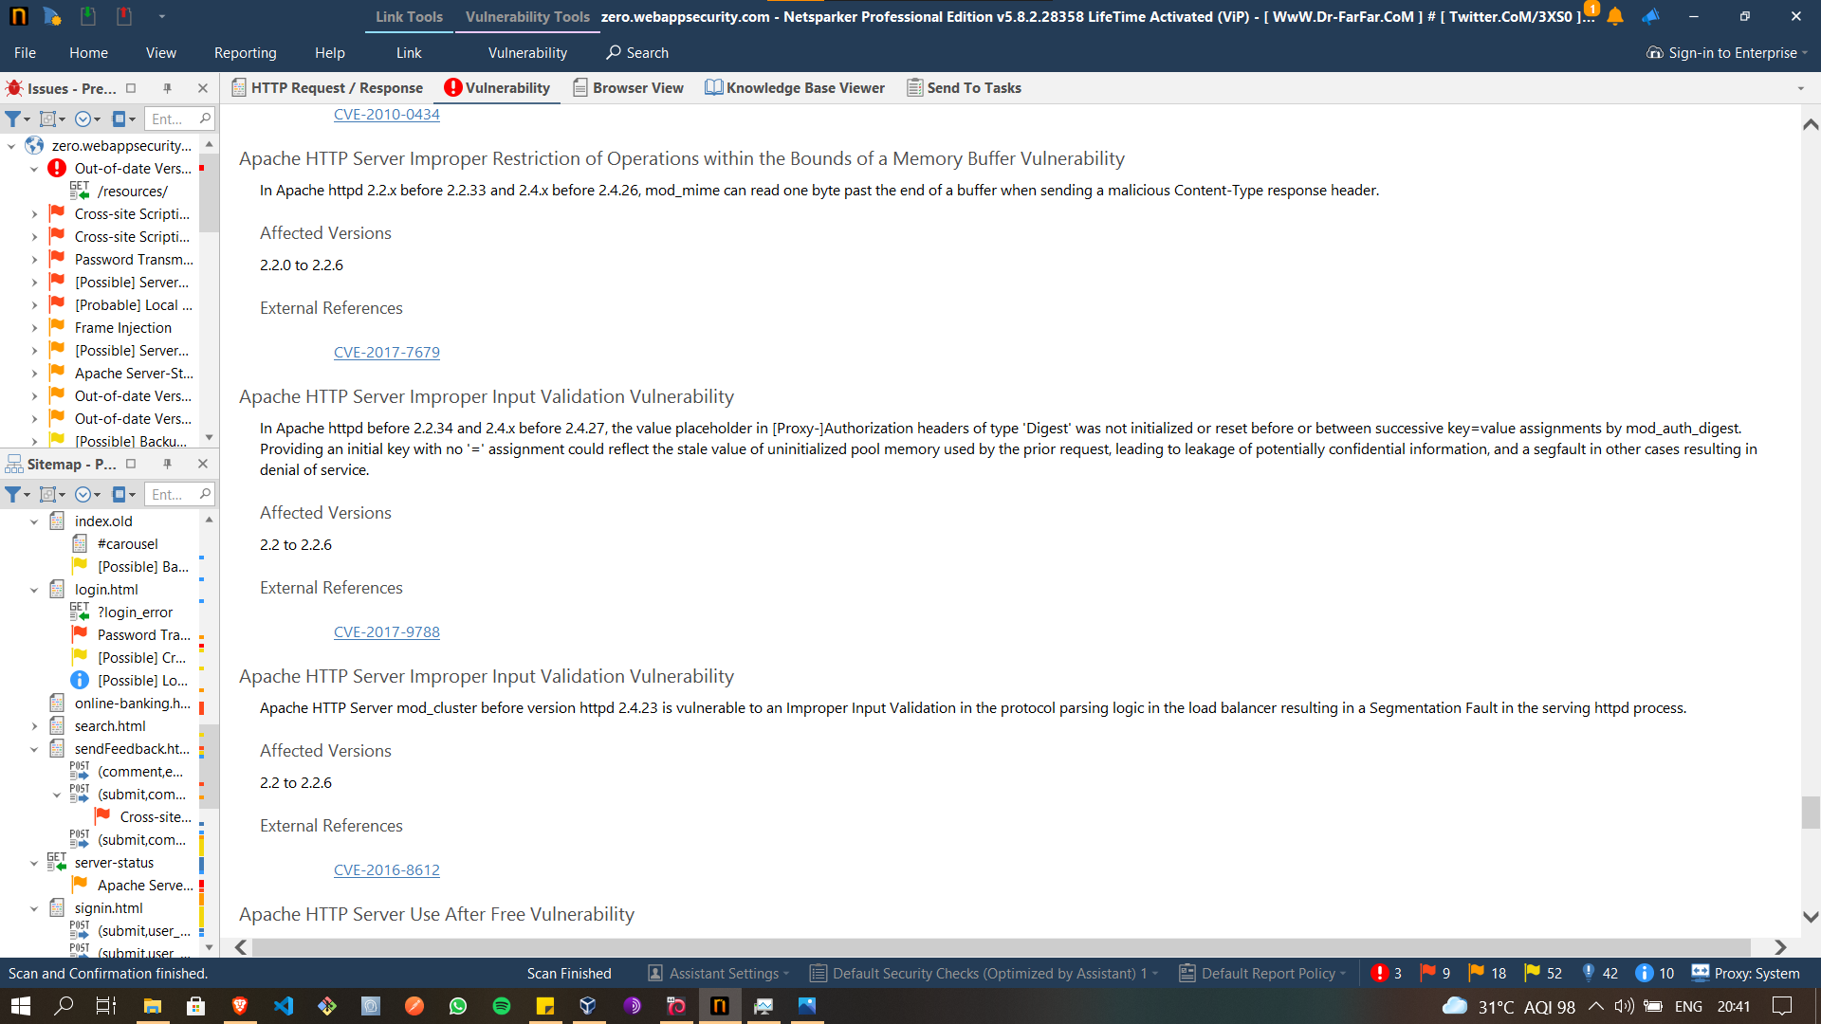

Slide 25
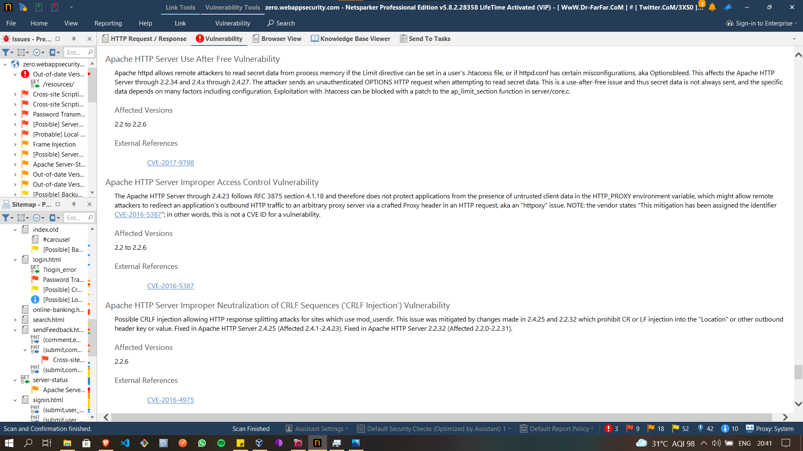

Slide 26
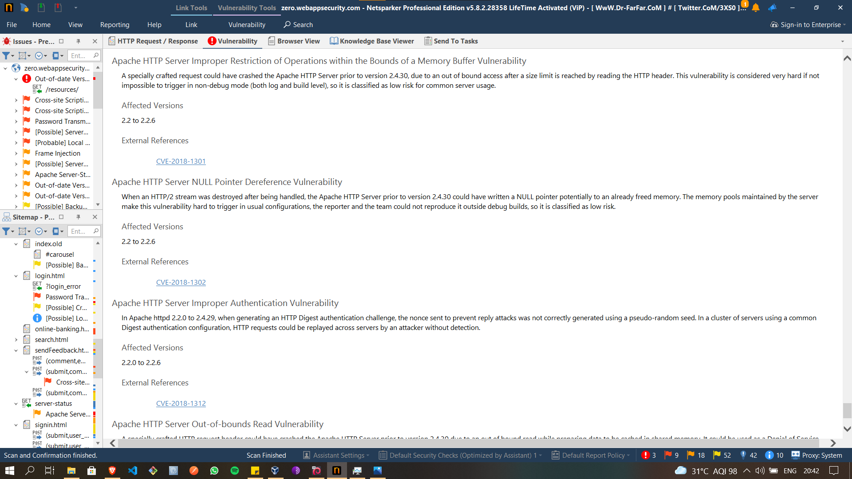

Slide 27
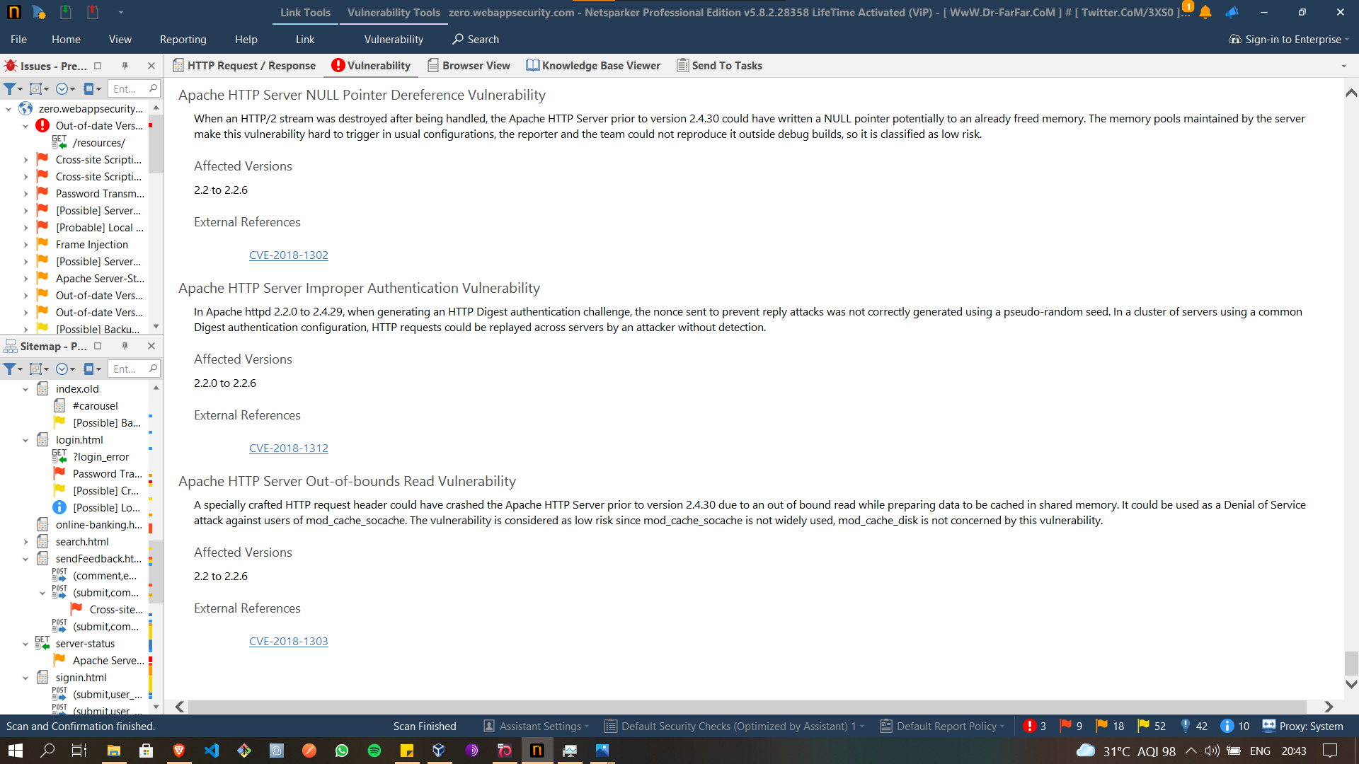

Slide 28
MY report

Slide 29
Vulnerability name: out of date version (apache sever)
Type of Vulnerability : Critical
Domain : https://zero.webappsecurity.com/
Version of this website : 2.2.6
Latest Version: 2.4.48 (Apache Server latest version)
Database: Result is based on 09/10/2021 20:30:00 vulnerability database content.

Slide 30
Vulnerability details and impact:
The netsparker software that was used for crawling the website found a critical vulnerability that the Apache server used to serve the web pages requested by client computers. The version is too old and as result a variety of vulnerability can be exploited.
Solution:
Though variety of actions can be undertaken the most feasible and simple way is to upgrade the installation of Apache to its latest stable version.
Reference to solution:
https://httpd.apache.org/download.cgi

Slide 31
Input validity vulnerability:
In this non upgraded version we can say that this vulnerability can cause remote attackers to cause denial of service via cookie manipulation

Slide 32
Race condition vulnerability:
This vulnerability can also cause the remote attackers to gain access and cause denial of service and or obtain sensitive credential information or execute arbitrary code via crafted request that triggers improper scoreboard.

Slide 33
Server Resource management errors vulnerability:
Resource computing is done by the attackers through crafted request that decompresses to a much larger size

Slide 34
Server Permissions, Privileges, and Access Controls Vulnerability:
It allows the user to place a zero length directory name in the LD_LIBRARY_PATH, which allows the local user to gain priviledges via Trojan horse DSO in the current working during execution of apachetl.

Slide 35
Apache HTTP Server Improper Neutralization of Input During Web Page Generation ('Cross-site Scripting') Vulnerability:
This type of vulnerability lead to XSS(Cross Site Scripting) where the attacker can change the contents of the website and run malicious code on it which in turn can leak the sensitive information from any users visiting the website.

Slide 36
Server Configuration Vulnerability:
The Apache HTTP Server 2.2.11 and earlier 2.2 versions does not properly handle Options=IncludesNOEXEC in the AllowOverride directive, which allows local users to gain privileges by configuring (1) Options Includes, (2) Options +Includes, or (3) Options +IncludesNOEXEC in a .htaccess file, and then inserting an exec element in a .shtml file.

Slide 37
Apache HTTP Server Numeric Errors Vulnerability:
The stream_reqbody_cl function in mod_proxy_http.c in the mod_proxy module in the Apache HTTP Server before 2.3.3, when a reverse proxy is configured, does not properly handle an amount of streamed data that exceeds the Content-Length value, which allows remote attackers to cause a denial of service (CPU consumption) via crafted requests.

Slide 38
Server Cross-Site Request Forgery (CSRF) Vulnerability
Cross-site request forgery (CSRF) vulnerability in the balancer-manager in mod_proxy_balancer for Apache HTTP Server 2.2.x allows remote attackers to gain privileges via unspecified vectors.

Slide 39
Server Improper Control of Generation of Code ('Code Injection') Vulnerability:
CRLF injection vulnerability in the mod_negotiation module in the Apache HTTP Server 2.2.6 and earlier in the 2.2.x series, 2.0.61 and earlier in the 2.0.x series, and 1.3.39 and earlier in the 1.3.x series allows remote authenticated users to inject arbitrary HTTP headers and conduct HTTP response splitting attacks by uploading a file with a multi-line name containing HTTP header sequences and a file extension, which leads to injection within a (1) "406 Not Acceptable" or (2) "300 Multiple Choices" HTTP response when the extension is omitted in a request for the file.

Slide 40
Server Exposure of Sensitive Information to an Unauthorized Actor Vulnerability:
Apache HTTP Server, when running on Linux with a document root on a Windows share mounted using smbfs, allows remote attackers to obtain unprocessed content such as source files for .php programs via a trailing "\" (backslash), which is not handled by the intended AddType directive

Slide 41
Server Cryptographic Issues Vulnerability:
The TLS protocol, and the SSL protocol 3.0 and possibly earlier, as used in Microsoft Internet Information Services (IIS) 7.0, mod_ssl in the Apache HTTP Server 2.2.14 and earlier, OpenSSL before 0.9.8l, GnuTLS 2.8.5 and earlier, Mozilla Network Security Services (NSS) 3.12.4 and earlier, multiple Cisco products, and other products, does not properly associate renegotiation handshakes with an existing connection, which allows man-in-the-middle attackers to insert data into HTTPS sessions, and possibly other types of sessions protected by TLS or SSL, by sending an unauthenticated request that is processed retroactively by a server in a post-renegotiation context, related to a "plaintext injection" attack, aka the "Project Mogul" issue.

Slide 42
Server Other Vulnerability:
The mod_proxy_ftp module in the Apache HTTP Server allows remote attackers to bypass intended access restrictions and send arbitrary commands to an FTP server via vectors related to the embedding of these commands in the Authorization HTTP header, as demonstrated by a certain module in VulnDisco Pack Professional 8.11.

Slide 43
Server Insufficient Information Vulnerability
modules/arch/win32/mod_isapi.c in mod_isapi in the Apache HTTP Server 2.0.37 through 2.0.63, 2.2.0 through 2.2.14, and 2.3.x before 2.3.7, when running on Windows, does not ensure that request processing is complete before calling isapi_unload for an ISAPI .dll module, which allows remote attackers to execute arbitrary code via unspecified vectors related to a crafted request, a reset packet, and "orphaned callback pointers."

Slide 44
Server Exposure of Sensitive Information to an Unauthorized Actor Vulnerability
The ap_read_request function in server/protocol.c in the Apache HTTP Server 2.2.x before 2.2.15, when a multithreaded MPM is used, does not properly handle headers in subrequests in certain circumstances involving a parent request that has a body, which might allow remote attackers to obtain sensitive information via a crafted request that triggers access to memory locations associated with an earlier request

Slide 45
Server Improper Restriction of Operations within the Bounds of a Memory Buffer Vulnerability
In Apache httpd 2.2.x before 2.2.33 and 2.4.x before 2.4.26, mod_mime can read one byte past the end of a buffer when sending a malicious Content-Type response header.

Slide 46
Server Use After Free Vulnerability:
Apache httpd allows remote attackers to read secret data from process memory if the Limit directive can be set in a user's .htaccess file, or if httpd.conf has certain misconfigurations, aka Optionsbleed. This affects the Apache HTTP Server through 2.2.34 and 2.4.x through 2.4.27. The attacker sends an unauthenticated OPTIONS HTTP request when attempting to read secret data. This is a use-after-free issue and thus secret data is not always sent, and the specific data depends on many factors including configuration. Exploitation with .htaccess can be blocked with a patch to the ap_limit_section function in server/core.c.

Slide 47
Server Improper Neutralization of CRLF Sequences ('CRLF Injection') Vulnerability
Possible CRLF injection allowing HTTP response splitting attacks for sites which use mod_userdir. This issue was mitigated by changes made in 2.4.25 and 2.2.32 which prohibit CR or LF injection into the "Location" or other outbound header key or value. Fixed in Apache HTTP Server 2.4.25 (Affected 2.4.1-2.4.23). Fixed in Apache HTTP Server 2.2.32 (Affected 2.2.0-2.2.31).

Slide 48
Server Improper Restriction of Operations within the Bounds of a Memory Buffer Vulnerability
A specially crafted request could have crashed the Apache HTTP Server prior to version 2.4.30, due to an out of bound access after a size limit is reached by reading the HTTP header. This vulnerability is considered very hard if not impossible to trigger in non-debug mode (both log and build level), so it is classified as low risk for common server usage.

Slide 49
Server NULL Pointer Dereference Vulnerability
When an HTTP/2 stream was destroyed after being handled, the Apache HTTP Server prior to version 2.4.30 could have written a NULL pointer potentially to an already freed memory. The memory pools maintained by the server make this vulnerability hard to trigger in usual configurations, the reporter and the team could not reproduce it outside debug builds, so it is classified as low risk.

Slide 50
Server Out-of-bounds Read Vulnerability
A specially crafted HTTP request header could have crashed the Apache HTTP Server prior to version 2.4.30 due to an out of bound read while preparing data to be cached in shared memory. It could be used as a Denial of Service attack against users of mod_cache_socache. The vulnerability is considered as low risk since mod_cache_socache is not widely used, mod_cache_disk is not concerned by this vulnerability

